Slide 1

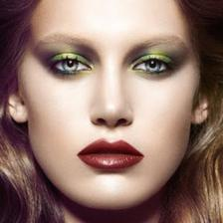
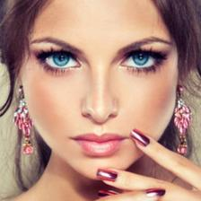
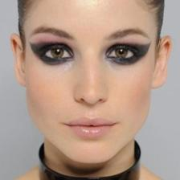
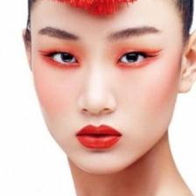
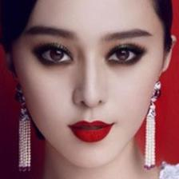
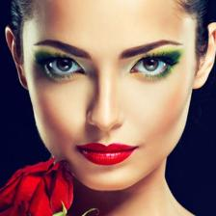
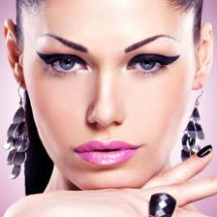
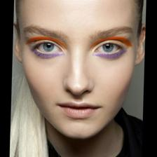
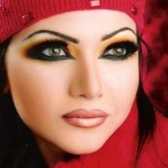
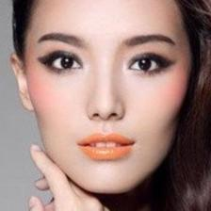
Xinyu Ou, Si Liu, Xiaochun Cao, Hefei Ling
Notes:
In this demo, we present a “Beauty eMakeup System” to automatically recommend the most suitable makeup for a female and synthesis the makeup on her face.
Given a before-makeup face, her most suitable makeup is determined automatically.
Then, both the before-makeup and the reference faces are fed into the proposed Deep Transfer Network to generate the after-makeup face.
Our end-to-end makeup transfer network have several nice properties including:
with complete functions: including foundation, lip gloss, and eye shadow transfer;
cosmetic specific: different cosmetics are transferred in different manners;
localized: different cosmetics are applied on different facial regions;
producing naturally looking results without obvious artifacts;
controllable makeup lightness: various results from light makeup to heavy makeup can be generated.

Slide 2

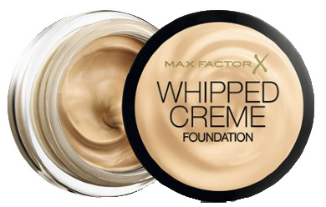
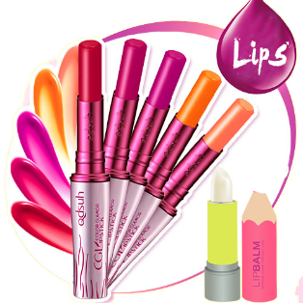
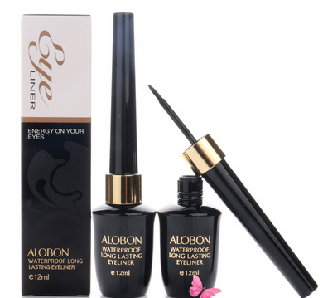

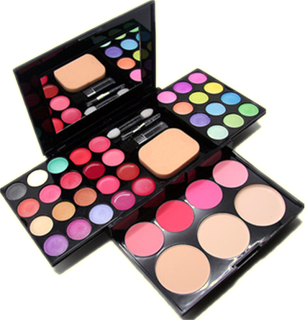
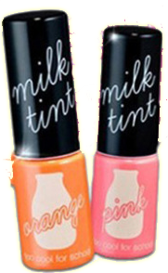
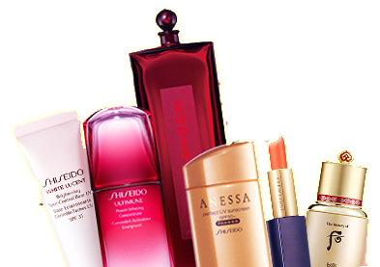
Foundation
Lipstick
Eye Liner
Eye shadow
Lip gloss
Notes:
Wow! What is a beauty?
All perfect!
Yes, except temperament, makeup is also an important part.
Such as foundation, lipstick, eye shadow, lip gloss, eye liner, and so on.

Slide 3

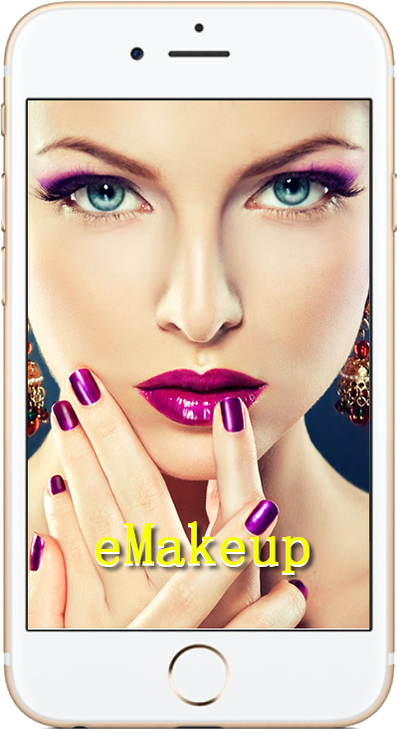
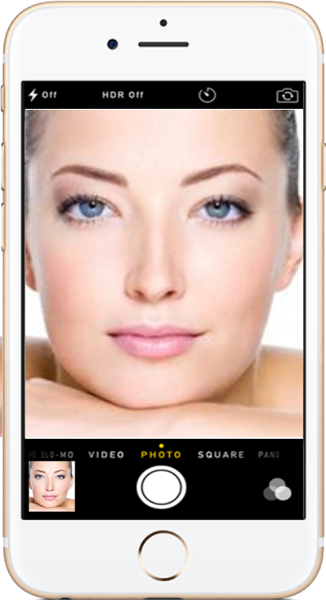
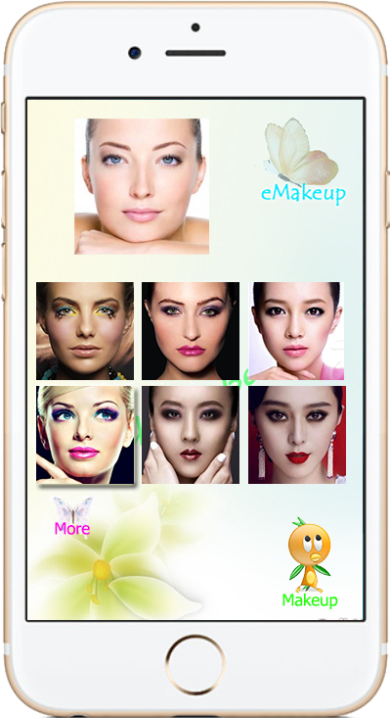
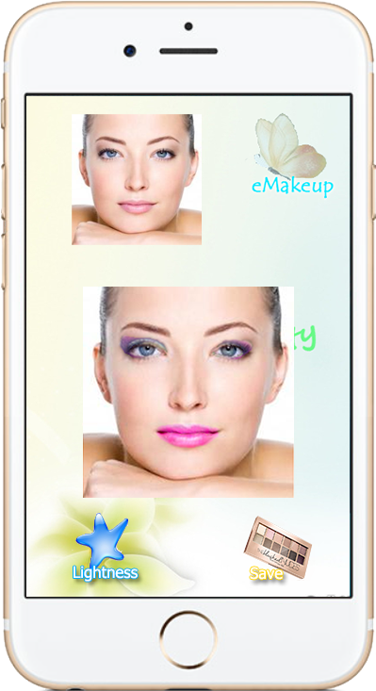
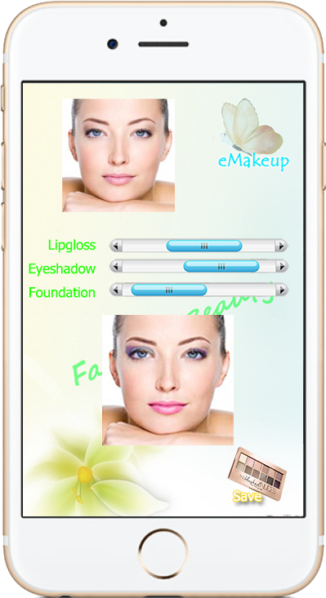
Modble APP - Whenever and Wherever
Welcome Take a photo Recommend Synthesize makeup Adjust lightness
Notes:
The Beauty eMakeup system is a mobile APP, now. It has multiple screens.
Welcome screen.
Take or upload a non-makeup photo.
Choice a favorite model from the recommendation set, which is automatically created by eMakup system. The model selected are according to the non-makeup photo.
Synthesize makeup photo.
Adjust the lightness of each makeup part.

Slide 4
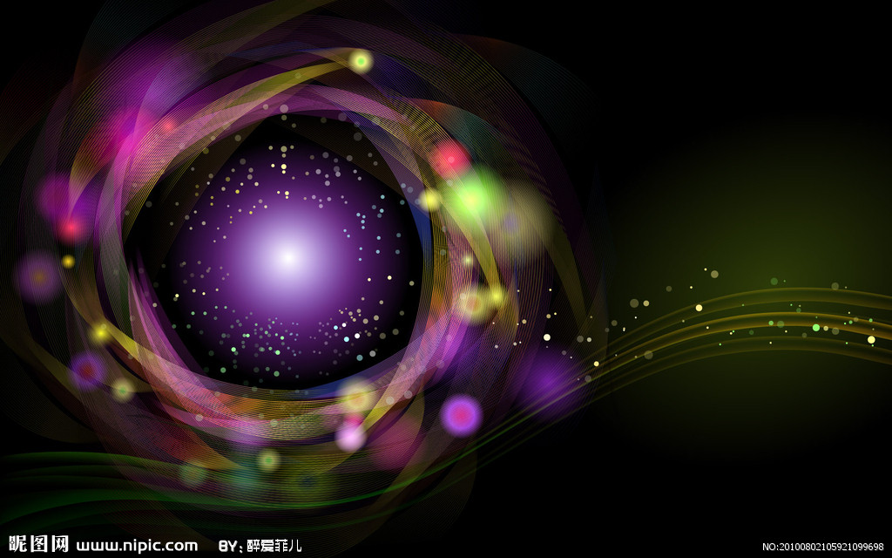
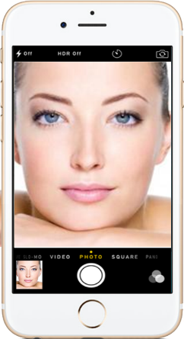
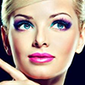


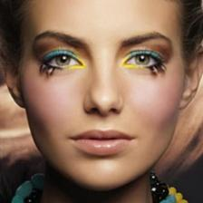
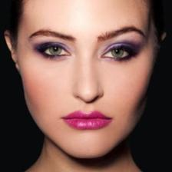
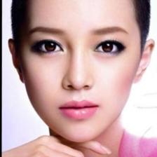
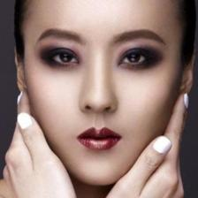
Take a photo and Recommend
Take a photo
Makeup
Notes:
The most important criterion of makeup recommendation is personalization.
Females that look like are suitable for similar makeups. Given a before-makeup face, we find several similar faces in the reference dataset.
The similarities are defined as the Euclidean distances between the deep features extracted by feeding the face into a pre-trained facial recognition model - VGGFace model. It is trained based on VGG16 CNN architecture and aims to accurately identify different people regardless of whether she puts on makeup. Therefore, the extracted features can capture the most discriminative structure of faces. Finally, the retrieved results serve as the reference faces to transfer their cosmetics to the before-makeup face.
This slide illustrates that the recommended reference faces have similar facial shapes with the before-makeup faces, and therefore the recommendation is personalized

Slide 5

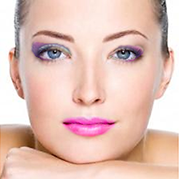
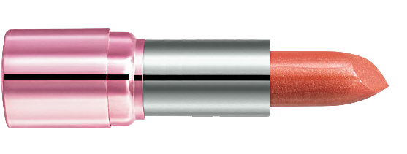
Satisfaction?
Recommend
Adjust Lightness
Notes:
After had a non-makeup photo and chose a reference makeup photo, the system will automatically synthesize a photo by default setting.
If the user is not satisfied with the recommended as a result, then she/he can have two options:
Back to recommendation screen, and reselect a satisfactory reference model.
Fine adjusts the lightness of each makeup part.

Slide 6

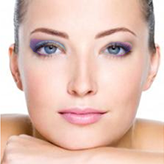
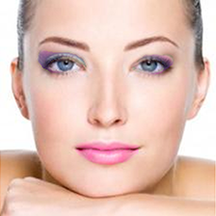
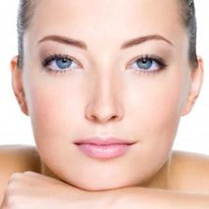

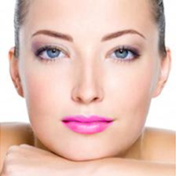

Lightness
Light Makeup Dark Makeup
Notes:
In order to demonstrate our method can generate after-makeup face with various makeup lightness, ranging from light makeup to dark makeup, we gradually increase certain makeup weights of each part (such as eye shadow, foundation, lip gloss).
This slide shows a girl wears the same reference faces with different lightness. The girl’s lip color becomes redder in the first row, and the eye shadows gradually darker while other cosmetics keep unchanged.

Slide 7


Link to Social Network
Share
Notes:
As a complete system. We expect our eMakeup system can provide a more convenient user environment for more people. Link to social network is a simple but effective method.
A uniform cloud system was developed to store amounts of makeup reference image for automatic recommendation.
User information and preference reference database are stored in the cloud system, and the user can use any terminal to update the preference dataset.
User can use any device (such as mobile phone, tablet PC or web browser) to capture and upload her/his photo to eMakeup system, then synthesized makeup photo.
The user’s preference reference database and synthesised makeup photo can be simple and fast share with her/his friends over the world by all kinds of social software, such as Flickr, Facebook, Tencent QQ, etc.

Slide 8

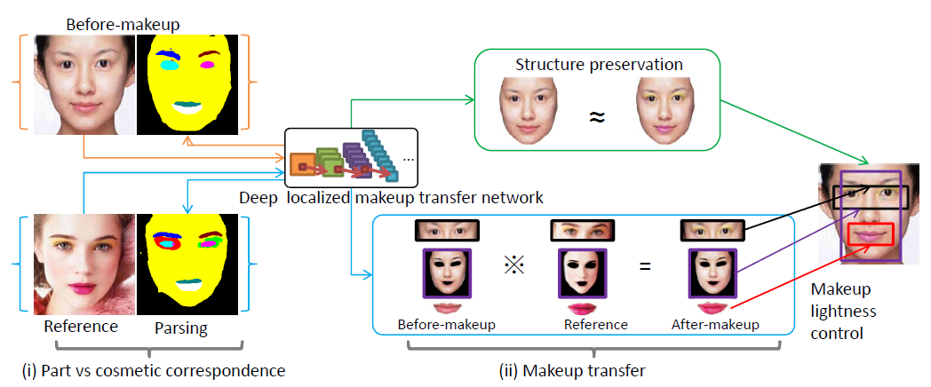
Deep Localized Makeup Transfer Network
The proposed Deep Localized Makeup Transfer Network contains two sequential steps. (i) the correspondences between the facial part (in the before-makeup face) and the cosmetic (in the reference face) are built based on the face parsing network. (ii) Eye shadow, foundation and lip gloss are locally transferred with a global smoothness regularization.
Notes:
This slide shows the network transfers the makeup from the recommended reference face to a before-makeup face.
1. Both before-makeup and reference faces are fed into a face parsing network to generate two corresponding label maps. (i) emphasizing the makeup relevant facial parts, and (ii) considering the symmetry structure of the frontal faces.
2. Three most common cosmetics, i.e, eye shadow, lip gloss and foundation are transferred in their own manners. (For example, keeping the shape is the most important for transferring eye shadow while the smoothing the skin’s texture is the most important for the foundation. So the eye shadow is transferred via directly altering the corresponding deep features while the foundation is transferred via regularizing the inner product of the feature maps)
3. The after-makeup face is initialized as the before-makeup face, then gradually updated via Stochastic Gradient Descent to produce naturally looking results.
4. By tuning up the weight of each cosmetic, a series of after-makeup faces with increasingly heavier makeup can be generated.

Slide 9

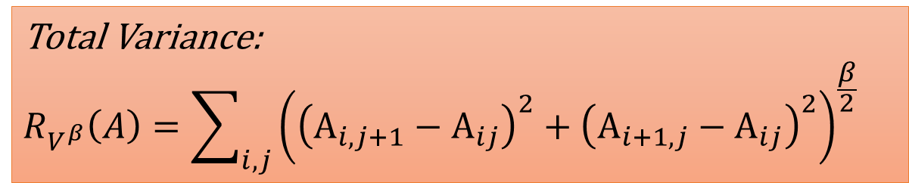
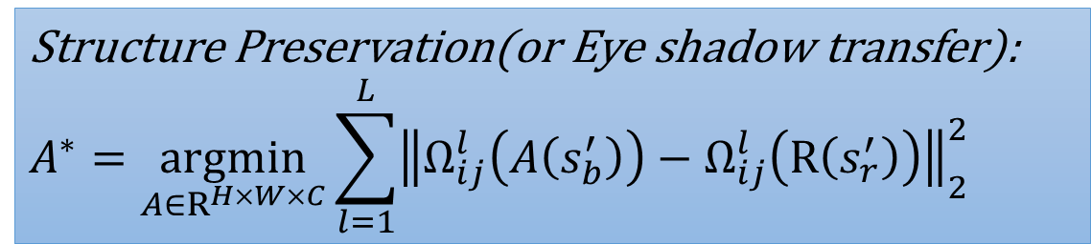
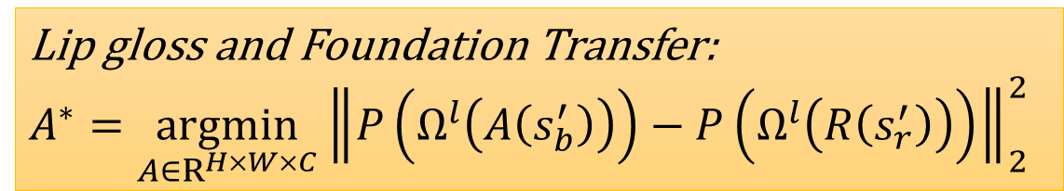
Deep Localized Makeup Transfer Network
$$A^{∗}=\underset{A∈R^{H×W×C}}{argmin}{{{λ_{l}\left(R_{up}\left(A\right)+R_{low}\left(A\right)\right)+λ_{f}R_{f}\left(A\right)+λ}_{s}R_{s}\left(A\right)+λ}_{e}\left(R_{l}\left(A\right)+R_{r}\left(A\right)\right)+R_{V^{β}}\left(A\right)}$$
Structure Preservation(or Eye shadow transfer):
$$A^{∗}=\underset{A∈R^{H×W×C}}{argmin}\sum_{l=1}^{L}{{\left\|Ω_{ij}^{l}\left(A\left(s_{b}^{′}\right)\right)−Ω_{ij}^{l}\left(R\left(s_{r}^{′}\right)\right)\right\|}_{2}^{2}}$$
Lip gloss and Foundation Transfer:
$$A^{∗}=\underset{A∈R^{H×W×C}}{argmin}{\left\|P\left(Ω^{l}\left(A\left(s_{b}^{′}\right)\right)\right)−P\left(Ω^{l}\left(R\left(s_{r}^{′}\right)\right)\right)\right\|}_{2}^{2}$$
Total Variance:
$$R_{V^{β}}\left(A\right)=\sum_{i,j}{{\left({\left(A_{i,j+1}−A_{ij}\right)}^{2}+{\left(A_{i+1,j}−A_{ij}\right)}^{2}\right)}^{\frac{β}{2}}}$$
Notes:
Makeup transfer is conducted based on the correspondences among image pairs. Here we will elaborate how to transfer eye shadow, lip gloss and foundation. Keeping the facial structure should also be considered and incorporated into the final objective function.
1. Structure Preservation (or Eye shadow transfer) needs to consider both the shape and color. Suppose s_{r} is the binary mask of left eye shadow in the reference face while s_{b} is the warped binary mask in the before-makeup face. As the Equ.2 shown, H, W and C are the height, width and channel number of the input image. $Ω$^{l} is the d-dim feature representation of the conv1-1 layer of the face parsing model, A and R are the after-makeup face and reference face, respectively. s’ _{b} and s’ _{r} are achieved by mapping s_{b} to s_{r} from the data layer to the conv1-1 layer via the convolutional feature masking. The only difference between structure preservation and eye shadow transfer is that every elements of s_{b} and s_{r} are 1 in structure preservation.
2. Lip Gloss and Foundation Transfer require transferring color and texture. Here, L is equal to the number of layers used. Technically, we use 5 layers, including conv1-1, conv2-1, conv3-1, conv4-1 and conv5-1. $Ω$^{l} is a Gram matrix, which is the inner product between the vectorised feature map i and j in layer l:
3. Total Variance R_{V}(A) is utilized to smooth adjacent pixels to make the results more natural.

Slide 10

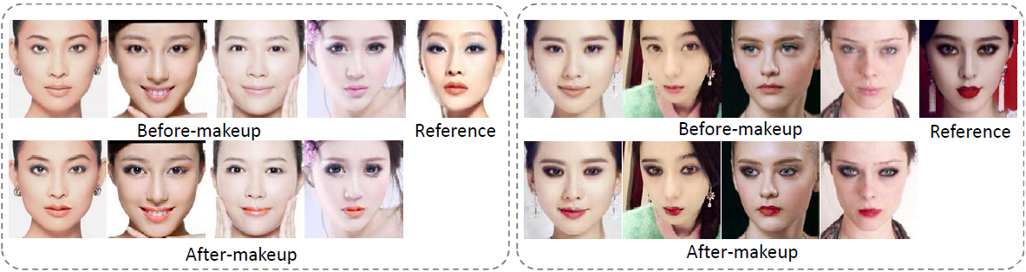
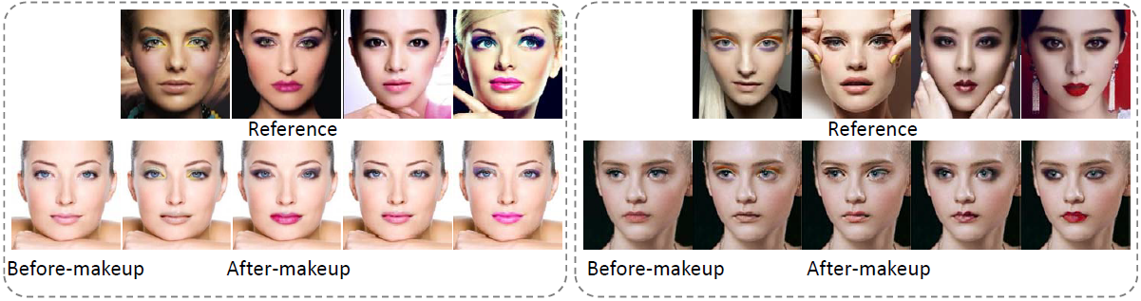
Different girls wear the same makeup
The same girl wears different makeups
Notes:
In the upper figure, for each reference face, we select five most similar looking before-makeup girls. Then the same makeup is applied on different before-makeup girls. It shows that the eye shadow, lip gloss and foundation are transferred successfully to the eyelid, lip and facial areas. Note that our method can handle the makeup transfer between different facial expressions. For example, the second girl in the left panel is grinning. However, the reference face is not smiling. Thanks to the localization property of our method, the lip gloss does not transfer to the teeth in the after-makeup face.
In the lower figure, for each before-makeup face, we select five most similar looking reference girls. This function is quite useful in real application, because the users can virtually try different makeup and choose the favorite one.

